Slide 1
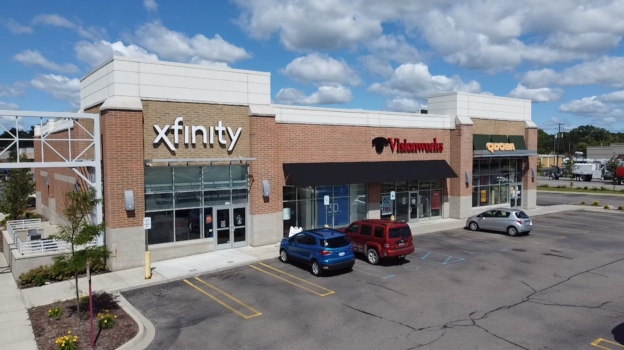
FOR LEASE
Rochester & Auburn shoppe’s | Rochester hills, MICHIGAN
ANTHONY SESI
SENIOR ASSOCIATE
asesi@cmprealestategroup.com
CHRIS JONNA
PRESIDENT
cjonna@cmprealestategroup.com

Slide 2
Rochester & auburn shoppe’s
Property summary
PROPERTY INFORMATION
Property Address | 3044 South Rochester Road
City/Township | Rochester Hills
Building Size | 32,218 SF
Space Available | 3,060 SF
Asking Rental Rate | $40.00 PSF
Estimated NNN’s | $7.50 PSF
Parking | 208 Spaces
Join
Area tenants & employers
Demographics (five-mile radius)
PROPERTY highlights
- | Join Starbucks, Qdoba, Xfinity, Mod Pizza and Vision Works located at Rochester and Auburn Roads.
- | 3,060 sf turnkey former dental office is available, which provides a great opportunity for a medical user to take advantage of.
- | In addition to high traffic counts, this site is accessible and visible from both Rochester and Auburn Roads.
- | Various national tenants operate in the immediate area, including high volume big box tenants, such as, Meijer, Lowe's, Kohl's, and Target.
Population
769,277 people
Median age
41.9 Years old
households
307,177
Consumer spending
$10.6 Billion annually
Avg household income
$107,138/annually
Daytime employees
416,682 employees
cmprealestategroup.com
2

Slide 3
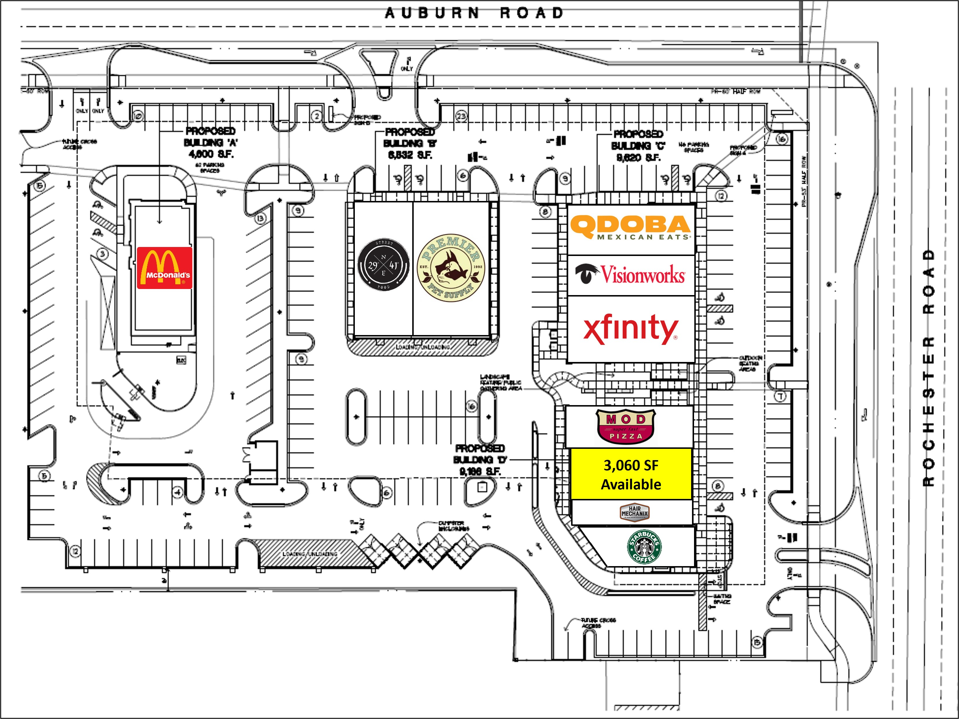
Rochester & auburn shoppe’s
Site plan
cmprealestategroup.com
3

Slide 4
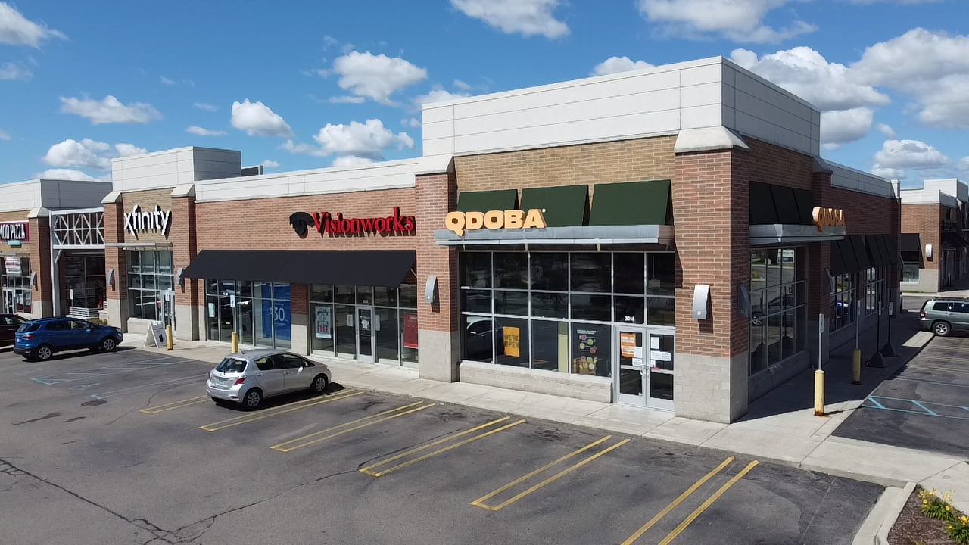
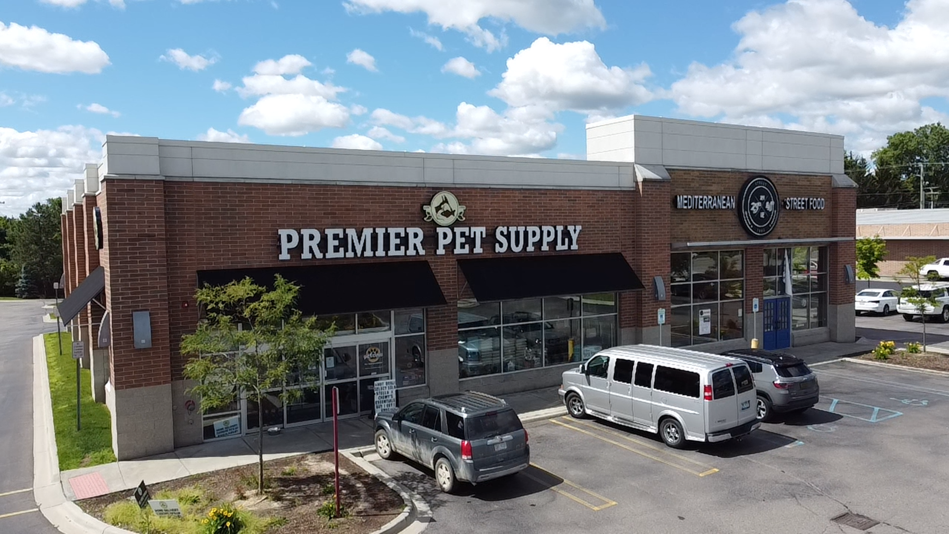
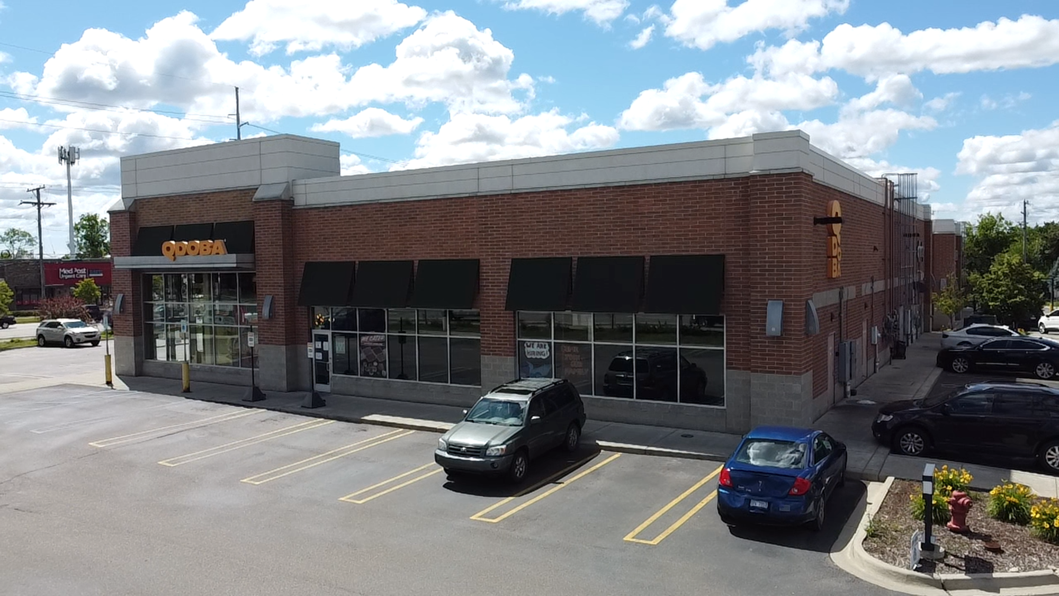
Rochester & auburn shoppe’s
picture
cmprealestategroup.com
4

Slide 5
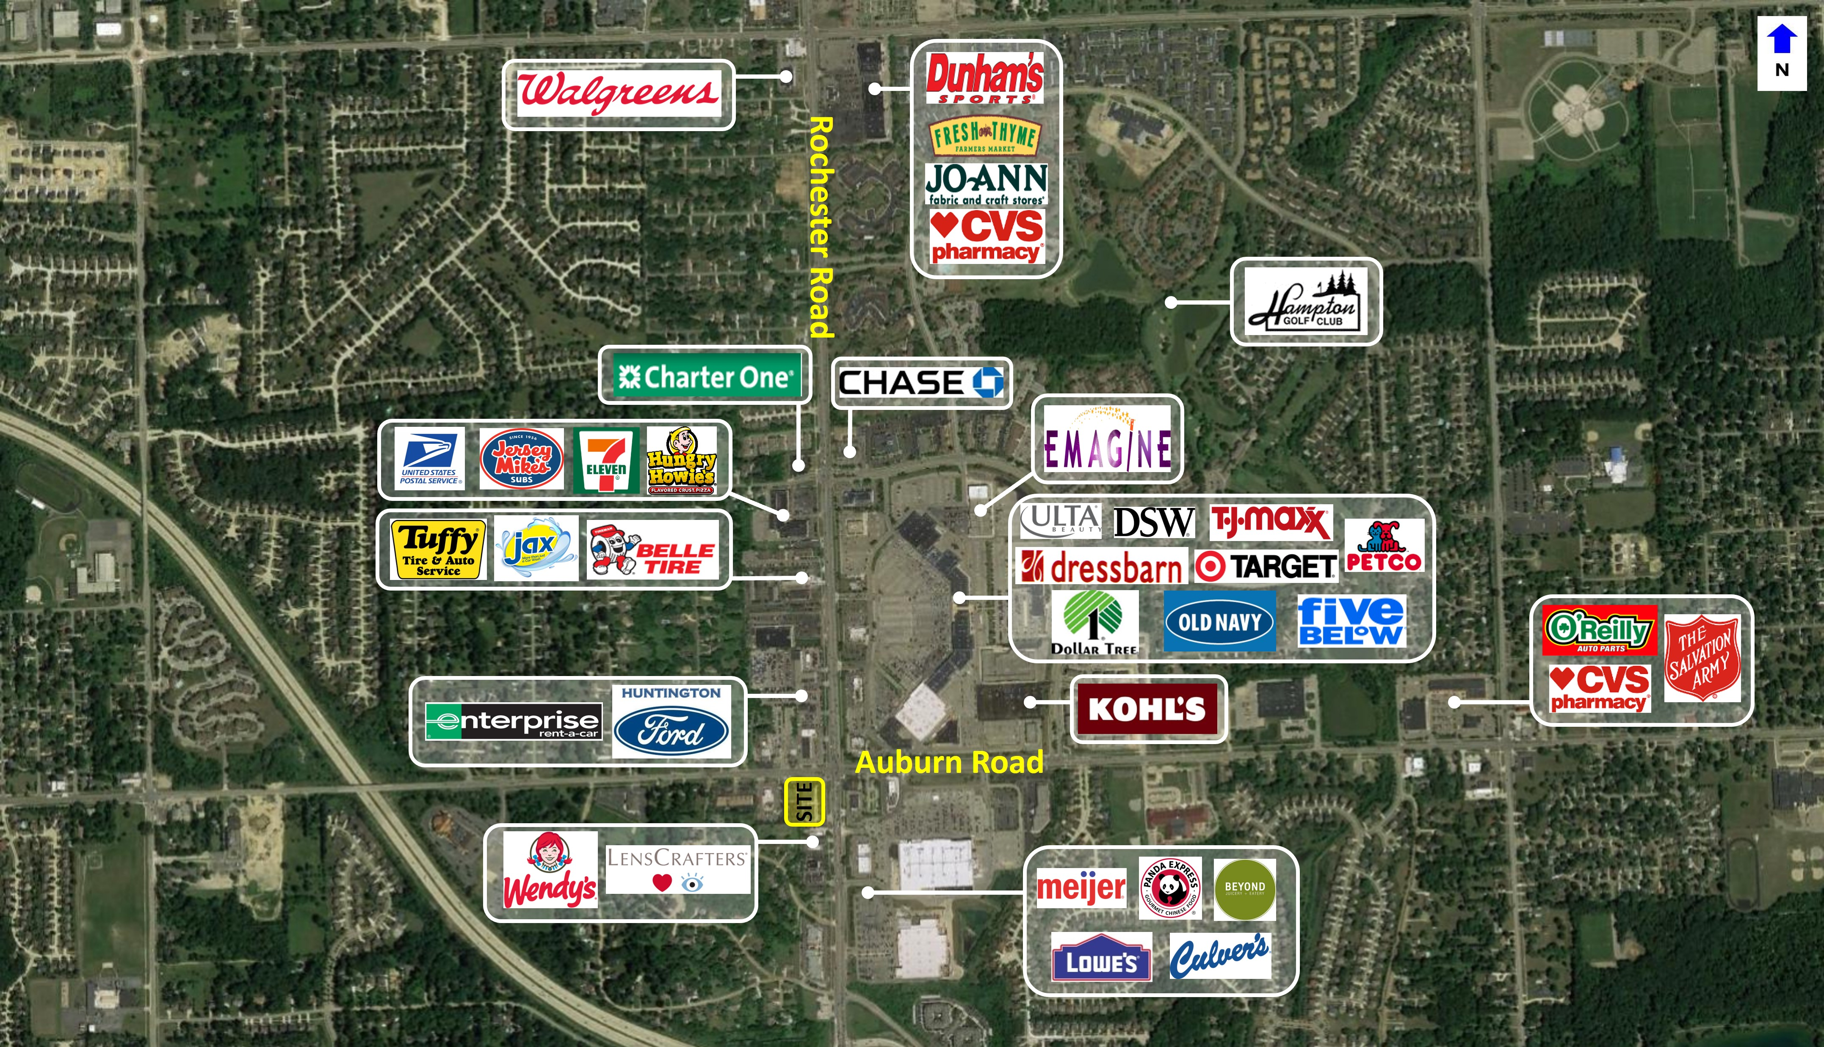
Rochester & auburn shoppe’s
Aerial
cmprealestategroup.com
5

Slide 6
Rochester & auburn shoppe’s
demographics
Population | 1 mile | 3 MILE | 5 Mile
2010 Population | 31,113 | 187,929 | 728,891
2023 Population | 33,055 | 202,297 | 769,277
2028 Population Projection | 33,360 | 204,571 | 775,183
Annual Growth 2010-2022 | 0.50% | 0.60% | 0.40%
Annual Growth 2022-2027 | 0.20% | 0.20% | 0.20%
Median Age | 41 | 41.7 | 41.9
Bachelor's Degree or Higher | 50% | 48% | 40%
households | 1 mile | 3 MILE | 5 Mile
2010 Households | 11,979 | 71,417 | 290,786
2023 Households | 12,675 | 77,020 | 307,177
2028 Household Projection | 12,783 | 77,911 | 309,584
Owner Occupied Households | 9,345 | 59,629 | 224,838
Renter Occupied Households | 3,438 | 18,282 | 84,745
Avg Household Income | 117,605 | 122,183 | 107,138
Median Household Income | 92,273 | 96,051 | 82,724
Population by race | 1 mile | 3 MILE | 5 Mile
White | 23,462 | 153,155 | 591,411
Black | 1,735 | 10,631 | 79,717
American Indian/Alaskan Native | 69 | 440 | 2,316
Asian | 7,005 | 33,039 | 76,106
Hawaiian & Pacific Islander | 8 | 41 | 282
Two or More Races | 775 | 4,991 | 19,446
Hispanic Origin | 1,205 | 7,736 | 36,780
income | 1 mile | 3 MILE | 5 Mile
$25,000 - 50,000 | 1,918 | 10,912 | 53,091
$50,000 - 75,000 | 2,371 | 11,536 | 48,472
$75,000 - 100,000 | 1,660 | 9,754 | 40,770
$100,000 - 125,000 | 1,519 | 8,961 | 34,015
$125,000 - 150,000 | 903 | 7,081 | 25,613
$150,000 - 200,000 | 1,781 | 8,555 | 29,167
$200,000+ | 1,622 | 12,372 | 36,621
cmprealestategroup.com
6

Slide 7
Rochester & auburn shoppe’s
Daytime population
Daytime employment | one mile |  |  | three mile |  |  | five mile
Daytime employment | Total Employees | Total Businesses | Employees Per Business | Total Employees | Total Businesses | Employees Per Business | Total Employees | Total Businesses | Employees Per Business
Service-Producing Industries | 13,167 | 1,730 | 8 | 78,934 | 8,666 | 9 | 350,604 | 38,807 | 9
Trade Transportation & Utilities | 4,031 | 242 | 17 | 13,117 | 1,067 | 12 | 75,406 | 5,551 | 14
Information | 422 | 29 | 15 | 1,990 | 146 | 14 | 9,827 | 772 | 13
Financial Activities | 620 | 125 | 5 | 8,959 | 921 | 10 | 39,009 | 4,419 | 9
Professional & Business Services | 1,412 | 157 | 9 | 10,328 | 1,244 | 8 | 53,020 | 5,842 | 9
Education & Health Services | 4,186 | 954 | 4 | 28,705 | 3,943 | 7 | 95,883 | 15,543 | 6
Leisure & Hospitality | 1,392 | 83 | 17 | 10,402 | 571 | 18 | 47,196 | 2,932 | 16
Other Services | 838 | 132 | 6 | 4,177 | 716 | 6 | 21,574 | 3,400 | 6
Public Administration | 266 | 8 | 33 | 1,256 | 58 | 22 | 8,689 | 348 | 25
Goods-Producing Industries | 1,711 | 131 | 13 | 13,820 | 807 | 17 | 66,078 | 3,659 | 18
Natural Resources & Mining | 2 | 1 | 2 | 75 | 12 | 6 | 232 | 47 | 5
Construction | 455 | 72 | 6 | 2,902 | 430 | 7 | 14,355 | 1,941 | 7
Manufacturing | 1,254 | 58 | 22 | 10,843 | 365 | 30 | 51,491 | 1,671 | 31
Total | 14,878 | 1,861 | 8 | 92,754 | 9,473 | 10 | 416,682 | 42,466 | 10
cmprealestategroup.com
7

Slide 8
The information contained in this Marketing Package does not purport to provide a complete or fully accurate summary of the Property or any of the documents related thereto, nor does it purport to all inclusive or to contain all the information, which a potential tenant may need or desire. All information contained herein has been secured by sources we believe to be reliable; however, CMP Real Estate Group, LLC (“Broker”) has not independently verified any of the information. This Marketing Package prepared by Broker, does not constitute an indication that there has been no change in the Property or the market conditions since the date of preparation of the information herein. Additional information and an opportunity to inspect the Property will be made available to the interested and qualified prospective tenant/purchaser, if available. Neither Owner nor Broker nor any of there respective officers, Agents or principals has made or will make any representations or warranties, express or implied, as to the accuracy or completeness of this Marketing Package or any of its contents, and no legal commitment or obligation shall arise by reason of the Marketing Package or its contents. Analysis and verification of the information contained in the Marketing Package is solely the responsibility of the prospective tenant/purchaser. Owner and Broker expressly reserve the right, at their sole discretion, to reject any or all expressions of interest or offers to lease/purchase the Property and/or terminate discussions with any entity at anytime with or without notice. Owner has no legal commitment or obligation to any entity reviewing this Marketing Package or making an offer to lease/purchase the Property unless and until such lease/sale of the Property is approved by Owner in its sole discretion, a written agreement for lease/purchase of the Property unless and until such sale of the Property is approved by Owner in its sole discretion, a written agreement for leased/purchase of the Property has been fully delivered, and approve by Owner, its legal counsel and any conditions to the Owner’s obligations thereunder have been satisfied or waived.
EXCLUSIVELY LISTED BY:
ANTHONY SESI
SENIOR ASSOCIATE
asesi@cmprealestategroup.com
CHRIS JONNA
PRESIDENT
cjonna@cmprealestategroup.com
Contact us:
6476 Orchard Lake Road, Suite A
West Bloomfield, Michigan 48322
(P): 248.538.2000
(F): 248.538.9905
Email: info@cmprealestategroup.com
Website: www.cmprealestategroup.com

